Slide 1
Unit I

Slide 2
Introduction to Computers
In today's world, we use computers for all our tasks. Our day-to-day activities: paying bills, buying groceries, using social media, seeking entertainment, working from home, communicating with a friend, etc., can all be done using a computer.
So it is important not only to know how to use a computer, but also to understand the components of a computer and what they do.

Slide 3
What is a Computer?
A computer is an electronic device that accepts data from the user, processes it, produces results, displays them to the users, and stores the results for future usage.
Data is a collection of unorganized facts & figures and does not provide any further information regarding patterns, context, etc. Hence data means "unstructured facts and figures".
Information is a structured data i.e. organized meaningful and processed data. To process the data and convert into information, a computer is used.

Slide 4
Functions of Computers
A computer performs the following functions −
Receiving Input: Data is fed into computer through various input devices like keyboard, mouse, digital pens, etc. Input can also be fed through devices like CD-ROM, pen drive, scanner, etc.
Processing the information: Operations on the input data are carried out based on the instructions provided in the programs.

Slide 5
Continue..
Storing the information: After processing, the information gets stored in the primary or secondary storage area.
Producing output: The processed information and other details are communicated to the outside world through output devices like monitor, printer, etc.

Slide 6
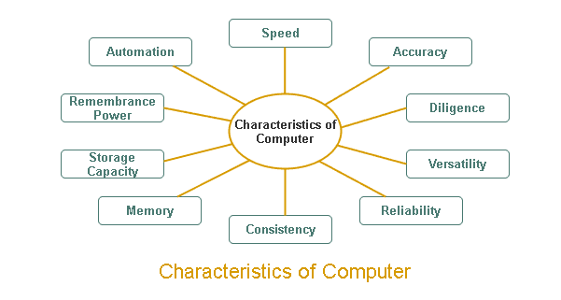
Characteristics of Computers

Slide 7
Continue..
Speed: A computer works with much higher speed and accuracy compared to humans while performing mathematical calculations. Computers can process millions (1,000,000) of instructions per second. The time taken by computers for their operations is microseconds and nanoseconds.
Accuracy: Computers perform calculations with 100% accuracy. Errors may occur due to data inconsistency or inaccuracy.

Slide 8
Continue..
Diligence: A computer can perform millions of tasks or calculations with the same consistency and accuracy. It doesn’t feel any fatigue or lack of concentration. Its memory also makes it superior to that of human beings.
Versatility: Versatility refers to the capability of a computer to perform different kinds of works with same accuracy and efficiency.
Automation: Computer performs all the tasks automatically i.e. it performs tasks without manual intervention.

Slide 9
Continue..
Reliability: A computer is reliable as it gives consistent result for similar set of data i.e., if we give same set of input any number of times, we will get the same result.
Memory: A computer has built-in memory called primary memory where it stores data. Secondary storage are removable devices such as CDs, pen drives, etc., which are also used to store data.

Slide 10
Continue..
Storage: Computer systems have a very large capacity to store any type of data. A computer can store and resell any information due to its storage capacity.
Computers have the ability to store all types of data such as data, pictures, files, programs, games, and sound for many years and later we can get any data in a few seconds at any time for taking that information and for future retrieval.

Slide 11
Continue..
No Feeling: In computers, like humans, there is no feeling and emotion, nor does the computer have any knowledge and experience, because a computer is a machine which works continuously on the instruction of humans without any selfishness and without tiredness.
No IQ: A computer is a dumb machine, without a user, a computer is a useless machine and device. Until a user does not give any instruction, it cannot do any work and only after completing the instruction, he completes that work very fast. A computer system is completely dependent on us humans how to work.

Slide 12
Generations of Computer
The development of computer systems is normally discussed as the development over different generations.
With the succession of different generations, came the advancement in computer technology.

Slide 13
First Generation
The period 1940 to 1956, roughly considered as the First Generation of Computer.
The first generation computers were developed by using vacuum tube or thermionic valve machine.
The input of this system was based on punched cards and paper tape; however, the output was displayed on printouts.
The first generation computers worked on binary-coded concept (i.e., language of 0-1). Examples: ENIAC, EDVAC, etc.

Slide 14
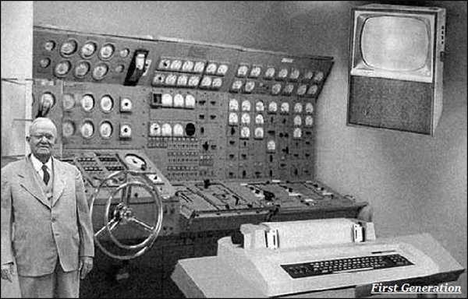
Continue.

Slide 15
Second Generation
The period 1956 to 1963 is roughly considered as the period of Second Generation of Computers.
The second generation computers were developed by using transistor technology.
In comparison to the first generation, the size of second generation was smaller.
In comparison to computers of the first generation, the computing time taken by the computers of the second generation was lesser.

Slide 16
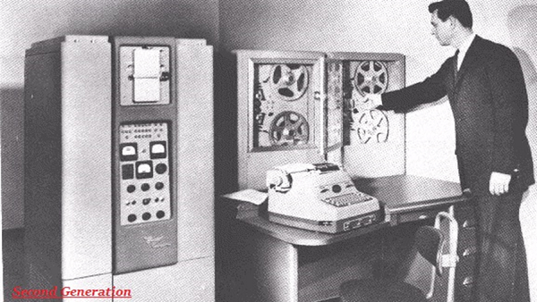
Continue..

Slide 17
Third Generation
The period 1963 to 1971 is roughly considered as the period of Third Generation of computers.
The third generation computers were developed by using the Integrated Circuit (IC) technology.
In comparison to the computers of the second generation, the size of the computers of the third generation was smaller.
In comparison to the computers of the second generation, the computing time taken by the computers of the third generation was lesser.

Slide 18
Continue..
The third generation computer consumed less power and also generated less heat.
The maintenance cost of the computers in the third generation was also low.
The computer system of the computers of the third generation was easier for commercial use.

Slide 19
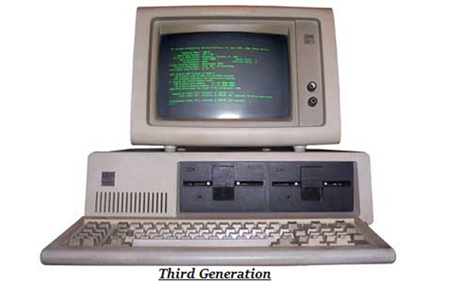
Continue..

Slide 20
Fourth Generation
The period 1972 to 2010 is roughly considered as the fourth generation of computers.
The fourth generation computers were developed by using microprocessor technology.
By coming to fourth generation, computer became very small in size, it became portable.
The machine of fourth generation started generating very low amount of heat.
It is much faster and accuracy became more reliable.
The production cost reduced to very low in comparison to the previous generation.
It became available for the common people as well.

Slide 21
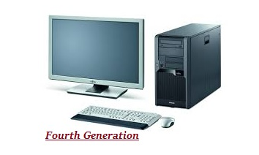
Continue..

Slide 22
Fifth Generation
The period 2010 to till date and beyond, roughly considered as the period of fifth generation of computers.
By the time, the computer generation was being categorized on the basis of hardware only, but the fifth generation technology also included software.
The computers of the fifth generation had high capability and large memory capacity.
Working with computers of this generation was fast and multiple tasks could be performed simultaneously.
Some of the popular advanced technologies of the fifth generation include Artificial intelligence, Quantum computation, Nanotechnology, Parallel processing, etc.

Slide 23
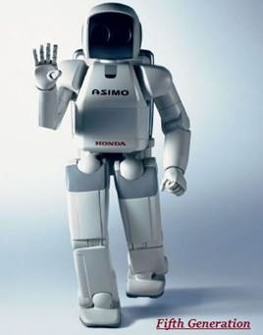
Continue..

Slide 24
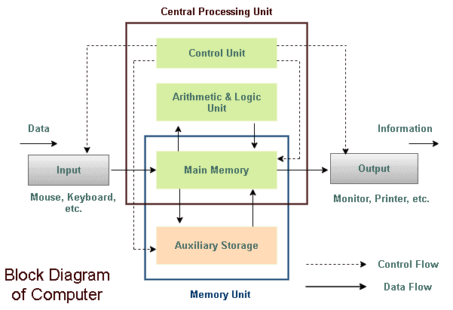
Block Diagram of Computer

Slide 25
Input Unit
All the data received by the computer goes through the input unit. The input unit comprises different devices. Like a mouse, keyboard, scanner, etc. In other words, each of these devices acts as a mediator between the users and the computer.
The data that is to be processed is put through the input unit. The computer accepts the raw data in binary form. It then processes the data, and produces the desired output.

Slide 26
Continue..
The 3 major functions of the input unit are-
  Take the data to be processed by the user.
  Convert the given data into machine-readable form.
  And then, transmit the converted data into the main memory of the computer. The sole purpose is to connect the user and the computer. In addition, this creates easy communication between them.

Slide 27
CPU – Central Processing Unit
Central Processing Unit or the CPU, is the brain of the computer. It works the same way a human brain works. As the brain controls all human activities, the CPU too controls all tasks.
Moreover, the CPU conducts all the arithmetical and logical operations in the computer.
Now the CPU comprises of two units, namely – ALU (Arithmetic Logic Unit) and CU (Control Unit). Both of these units work in sync. The CPU processes the data as a whole.

Slide 28
ALU – Arithmetic Logic Unit
The Arithmetic Logic Unit is made of two terms, arithmetic and logic. There are two major functions that this unit performs.
Data inserted through the input unit into the primary memory. Performs the basic arithmetical operation on it. Like addition, subtraction, multiplication, and division. It performs all sorts of calculations required on the data. Then sends back data to the storage.
The unit is also responsible for performing logical operations like, AND, OR, Equal to, Less than, etc. In addition to this it conducts merging, sorting, and selection of the given data.

Slide 29
CU – Control Unit
The control unit as the name suggests is the controller of all the activities/tasks and operations. All this is performed inside the computer.
The memory unit sends a set of instructions to the control unit. Then the control unit in turn converts those instructions. After that these instructions are converted to control signals.
These control signals help in prioritizing and scheduling the activities. Thus, the control unit coordinates the tasks inside the computer in sync with the input and output units.

Slide 30
Memory Unit
All the data that has to be processed or has been processed is stored in the memory unit. The memory unit acts as a hub of all the data. It transmits it to the required part of the computer whenever necessary.
The memory unit works in sync with the CPU. This helps in faster accessing and processing of the data. Thus, making tasks easier and faster.

Slide 31
Output
There is nothing to be amazed by what the output unit is used for. All the information sent to the computer once processed is received by the user through the output unit. Devices like printers, monitors, projector, etc. all come under the output unit.
The output unit displays the data either in the form of a soft copy or hard copy. The printer is for the hard copy. The monitor is for the display. The output unit accepts the data in binary form from the computer. It then converts it into a readable form for the user.

Slide 32
Number System Conversion
There are many methods or techniques which can be used to convert numbers from one base to another. We'll demonstrate here the following −
Decimal to Other Base System
Other Base System to Decimal
Other Base System to Non-Decimal
Shortcut method − Binary to Octal
Shortcut method − Octal to Binary
Shortcut method − Binary to Hexadecimal
Shortcut method − Hexadecimal to Binary

Slide 33
Decimal to Other Base System
Step 1 − Divide the decimal number to be converted by the value of the new base.
Step 2 − Get the remainder from Step 1 as the rightmost digit (least significant digit) of new base number.
Step 3 − Divide the quotient of the previous divide by the new base.
Step 4 − Record the remainder from Step 3 as the next digit (to the left) of the new base number.
Repeat Steps 3 and 4, getting remainders from right to left, until the quotient becomes zero in Step 3.
The last remainder thus obtained will be the Most Significant Digit (MSD) of the new base number.

Slide 34
Example −
Decimal Number: 29
Calculating Binary Equivalent −
Step | Operation | Result | Remainder
Step 1 | 29 / 2 | 14 | 1
Step 2 | 14 / 2 | 7 | 0
Step 3 | 7 / 2 | 3 | 1
Step 4 | 3 / 2 | 1 | 1
Step 5 | 1 / 2 | 0 | 1

Slide 35
Continue..
As mentioned in Steps 2 and 4, the remainders have to be arranged in the reverse order so that the first remainder becomes the Least Significant Digit (LSD) and the last remainder becomes the Most Significant Digit (MSD).
Decimal Number − 29 = Binary Number − 11101.

Slide 36
Other Base System to Decimal System
Step 1 − Determine the column (positional) value of each digit (this depends on the position of the digit and the base of the number system).
Step 2 − Multiply the obtained column values (in Step 1) by the digits in the corresponding columns.
Step 3 − Sum the products calculated in Step 2. The total is the equivalent value in decimal.

Slide 37
Example
Binary Number − 111012
Calculating Decimal Equivalent −
Binary Number − 111012 = Decimal Number − 2910
Step | Binary Number | Decimal Number
Step 1 | 11101₂ | ((1 × 2⁴) + (1 × 2³) + (1 × 2²) + (0 × 2¹) + (1 × 2⁰))₁₀
Step 2 | 11101₂ | (16 + 8 + 4 + 0 + 1)₁₀
Step 3 | 11101₂ | 29₁₀

Slide 38
Other Base System to Non-Decimal System
Step 1 − Convert the original number to a decimal number (base 10).
Step 2 − Convert the decimal number so obtained to the new base number.
Example
Octal Number − 258
Calculating Binary Equivalent −

Slide 39
Step 1 − Convert to Decimal
Octal Number − 258 = Decimal Number − 2110
Step | Octal Number | Decimal Number
Step 1 | 25₈ | ((2 × 8¹) + (5 × 8⁰))₁₀
Step 2 | 25₈ | (16 + 5 )₁₀
Step 3 | 25₈ | 21₁₀

Slide 40
Step 2 − Convert Decimal to Binary
Step | Operation | Result | Remainder
Step 1 | 21 / 2 | 10 | 1
Step 2 | 10 / 2 | 5 | 0
Step 3 | 5 / 2 | 2 | 1
Step 4 | 2 / 2 | 1 | 0
Step 5 | 1 / 2 | 0 | 1

Slide 41
Continue..
Decimal Number − 2110 = Binary Number − 101012
Octal Number − 258 = Binary Number − 101012

Slide 42
Shortcut method - Binary to Octal
Step 1 − Divide the binary digits into groups of three (starting from the right).
Step 2 − Convert each group of three binary digits to one octal digit.
Example: Binary Number − 101012
Calculating Octal Equivalent − Binary Number − 101012 = Octal Number − 258
Step | Binary Number | Octal Number
Step 1 | 10101₂ | 010 101
Step 2 | 10101₂ | 2₈ 5₈
Step 3 | 10101₂ | 25₈

Slide 43
Shortcut method - Octal to Binary
Step 1 − Convert each octal digit to a 3 digit binary number (the octal digits may be treated as decimal for this conversion).
Step 2 − Combine all the resulting binary groups (of 3 digits each) into a single binary number.
Example: Octal Number − 258

Slide 44
Continue..
Calculating Binary Equivalent −
Octal Number − 258 = Binary Number − 101012
Step | Octal Number | Binary Number
Step 1 | 25₈ | 2₁₀ 5₁₀
Step 2 | 25₈ | 010₂ 101₂
Step 3 | 25₈ | 010101₂

Slide 45
Shortcut method - Binary to Hexadecimal
Step 1 − Divide the binary digits into groups of four (starting from the right).
Step 2 − Convert each group of four binary digits to one hexadecimal symbol.
Example: Binary Number − 101012

Slide 46
Continue..
Calculating hexadecimal Equivalent −
Binary Number − 101012 = Hexadecimal Number − 1516
Step | Binary Number | Hexadecimal Number
Step 1 | 10101₂ | 0001 0101
Step 2 | 10101₂ | 1₁₀ 5₁₀
Step 3 | 10101₂ | 15₁₆

Slide 47
Shortcut method - Hexadecimal to Binary
Step 1 − Convert each hexadecimal digit to a 4 digit binary number (the hexadecimal digits may be treated as decimal for this conversion).
Step 2 − Combine all the resulting binary groups (of 4 digits each) into a single binary number.
Example: Hexadecimal Number − 1516

Slide 48
Continue..
Step | Hexadecimal Number | Binary Number
Step 1 | 15₁₆ | 1₁₀ 5₁₀
Step 2 | 15₁₆ | 0001₂ 0101₂
Step 3 | 15₁₆ | 00010101₂
Hexadecimal Number − 1516 = Binary Number − 101012

